Slide 1
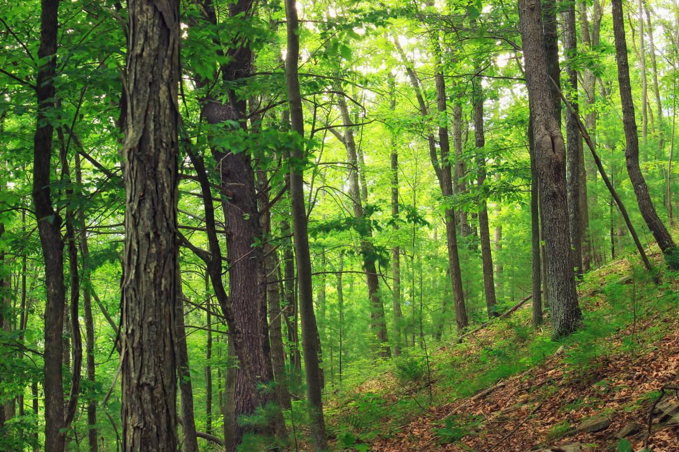

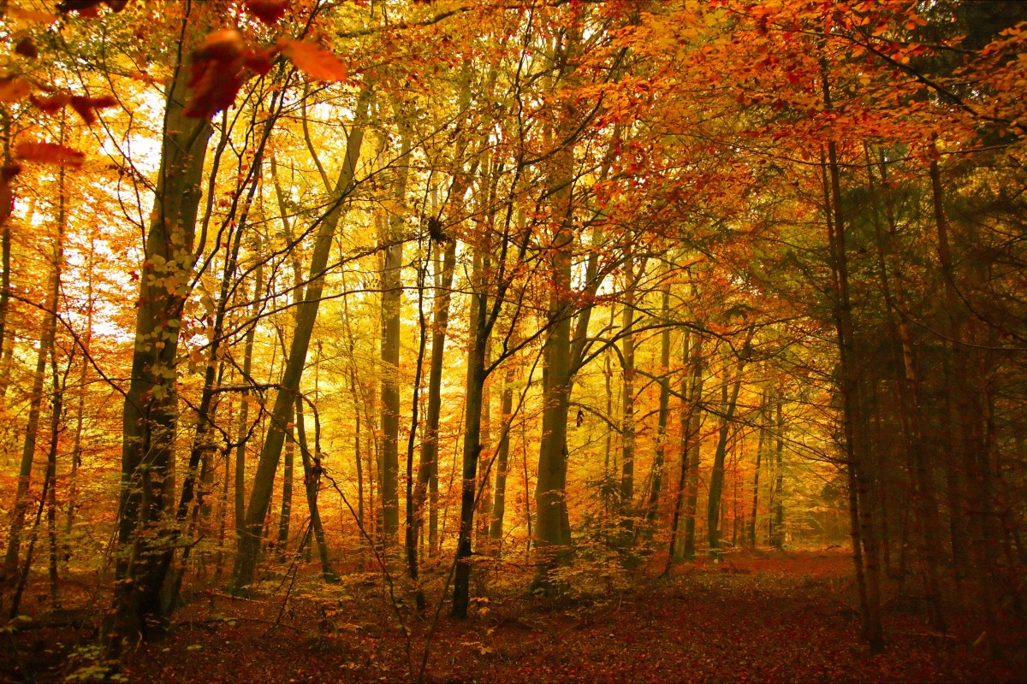
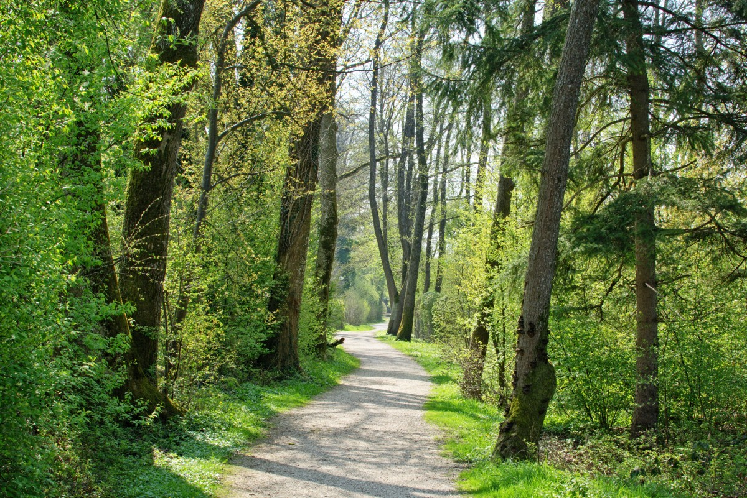
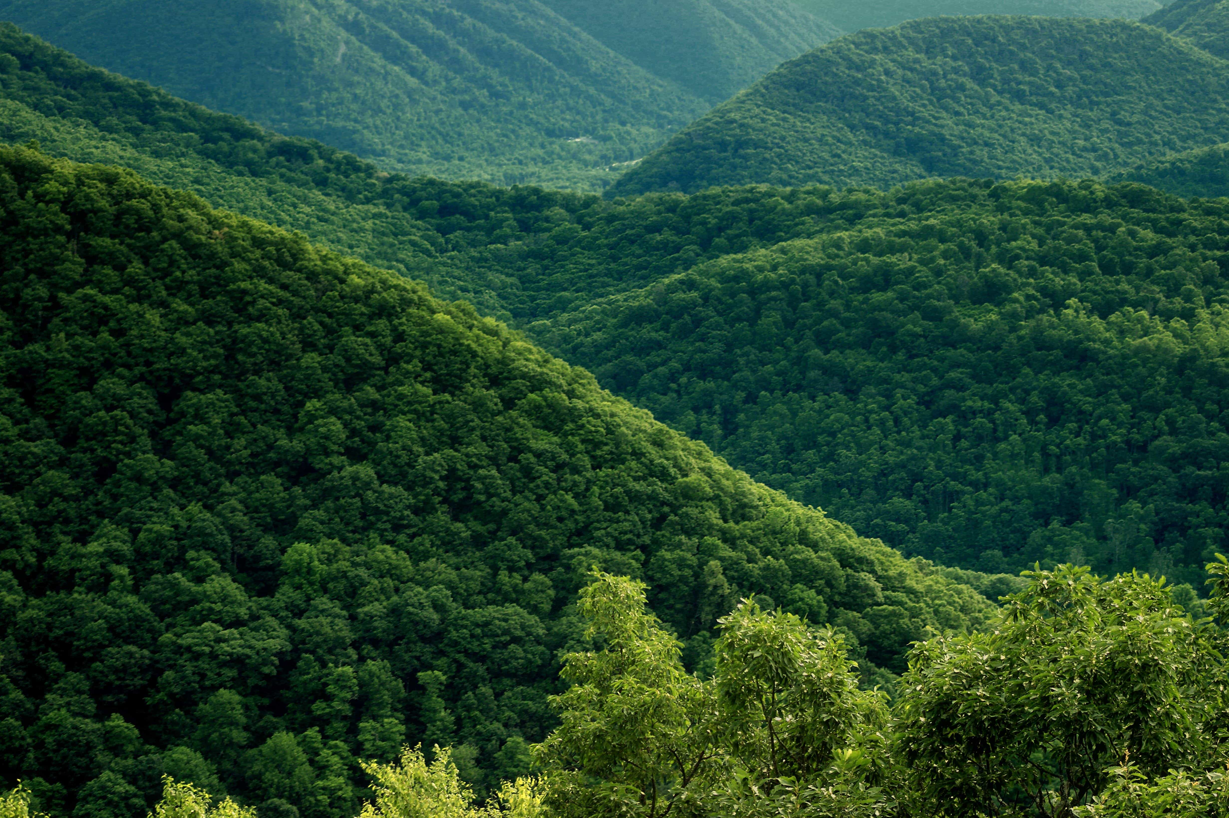
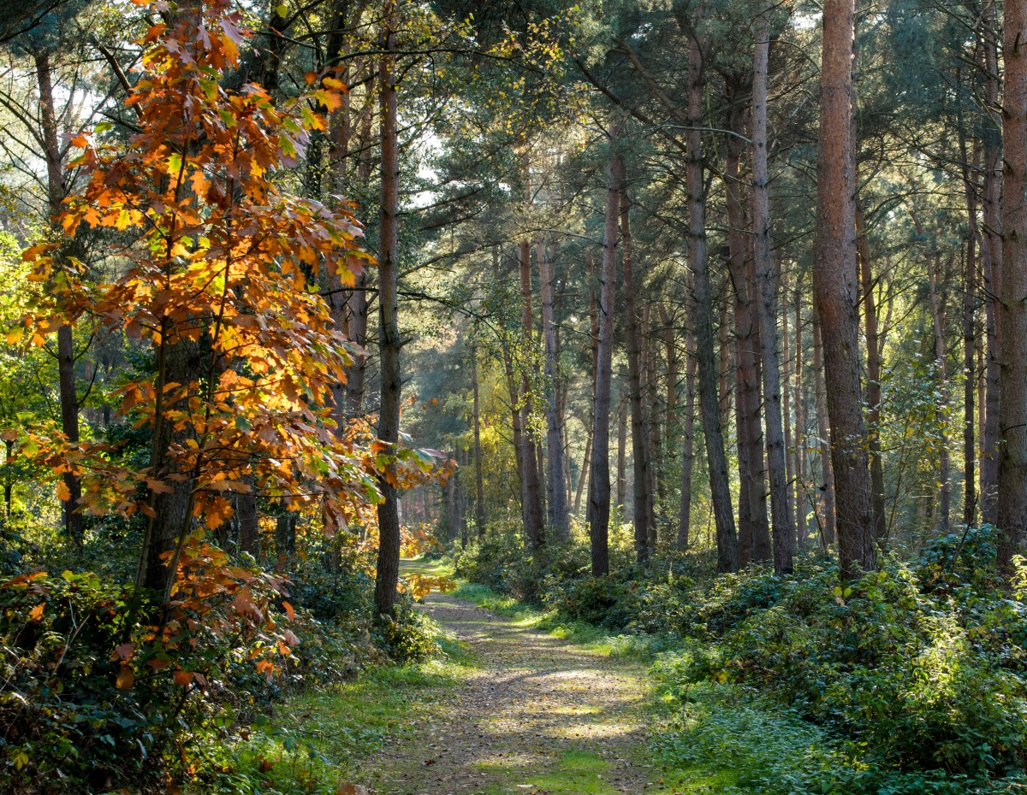
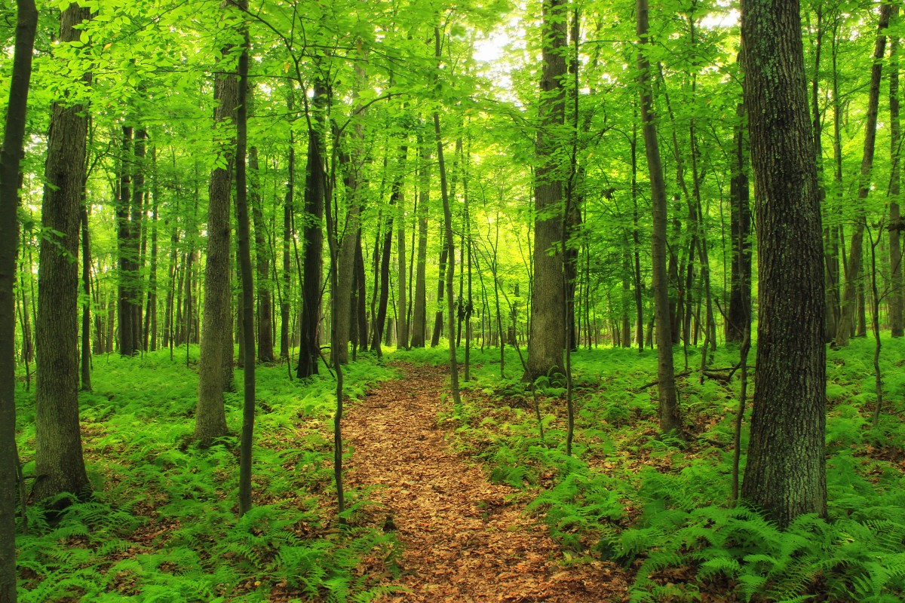
Forest Cover Type Prediction Using Machine Learning
Presented by – Aritra Mukherjee
ID: UMIP270247
Machine Learning Intern
At - Unified Mentor Pvt. Limited
Aritra Mukherjee

Slide 2
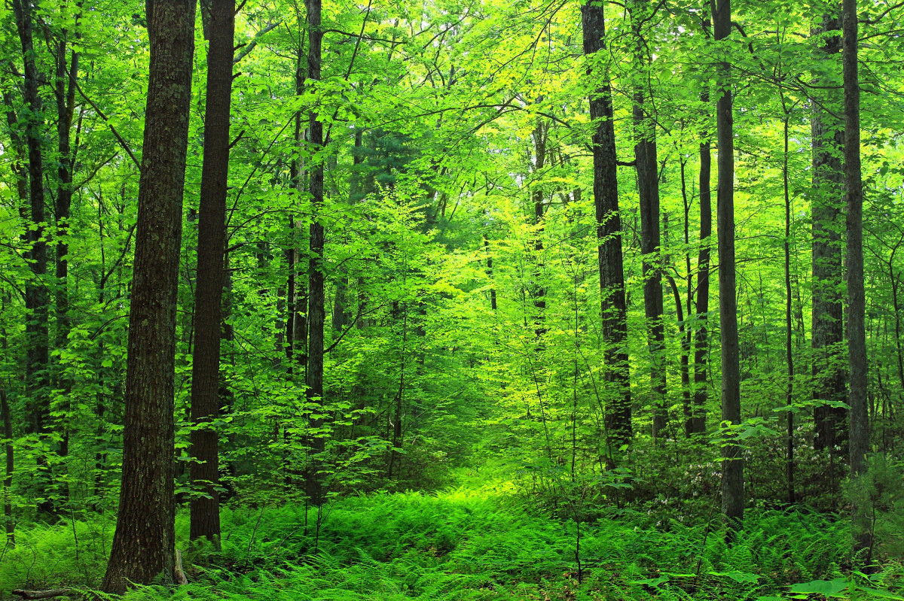
Introduction To Project –
Animal Classification
The Forest Cover Type Prediction project uses geographical and cartographic features to predict the type of forest cover.
It is based on the Roosevelt National Forest in northern Colorado.
Helps in ecological planning, forest management, and environmental monitoring.
Aritra Mukherjee

Slide 3

GOAL
Predicting Vegetation Types Based on Cartographic Features.
Build a machine learning model to predict one of the 7 forest cover types based on input features like elevation, slope, soil type, etc.
Deploy a user-friendly Gradio-based web application where users can input data and get real-time predictions.
Aritra Mukherjee

Slide 4
Dataset Overview for Classification
Dataset:
Forest Cover Type Dataset – Given By Unified Mentor Pvt. Lim
Features:
Numerical: Elevation, Slope, Aspect, Distances, Hillshades
Categorical (One-hot): 4 Wilderness Areas, 40 Soil Types
Target Classes (7 types):
Spruce/Fir
Lodgepole Pine
Ponderosa Pine
Cottonwood/Willow
Aspen
Douglas-fir
Krummholz
Aritra Mukherjee

Slide 5

Tech Stack
Technologies & Tools Used
♦️Programming Language:
Python
♦️ Libraries:
Scikit-learn – Random Forest Model
Joblib – Model serialization
NumPy – Data handling
Gradio – Web-based user interface
♦️ Tools:
Jupyter Notebook (for training and analysis)
VS Code - Virtual Python environment
Gradio Blocks for deployment
Aritra Mukherjee

Slide 6
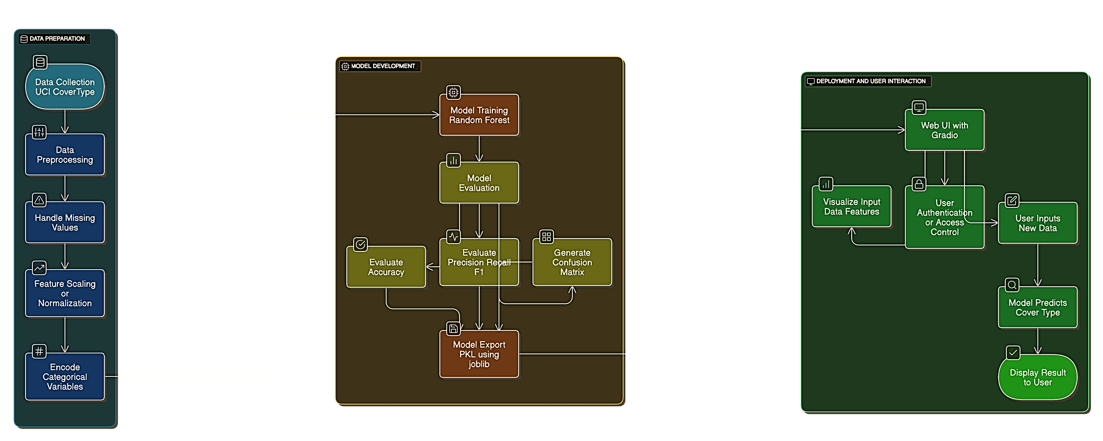
Work Flowchart

Slide 7
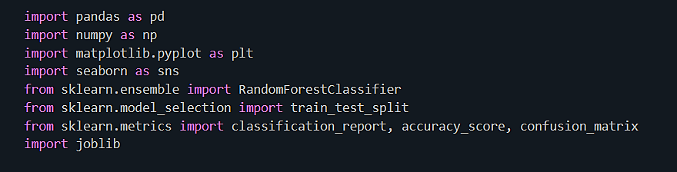
Import Required Libraries
Aritra Mukherjee

Slide 8
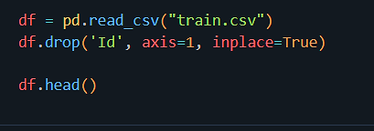
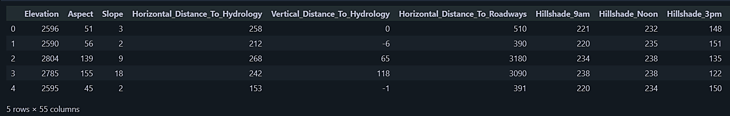
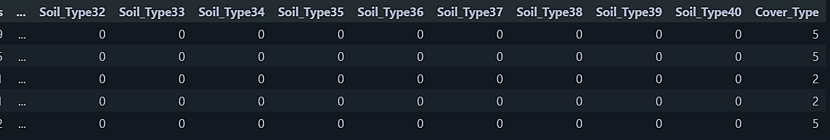
Load The Dataset
Aritra Mukherjee

Slide 9
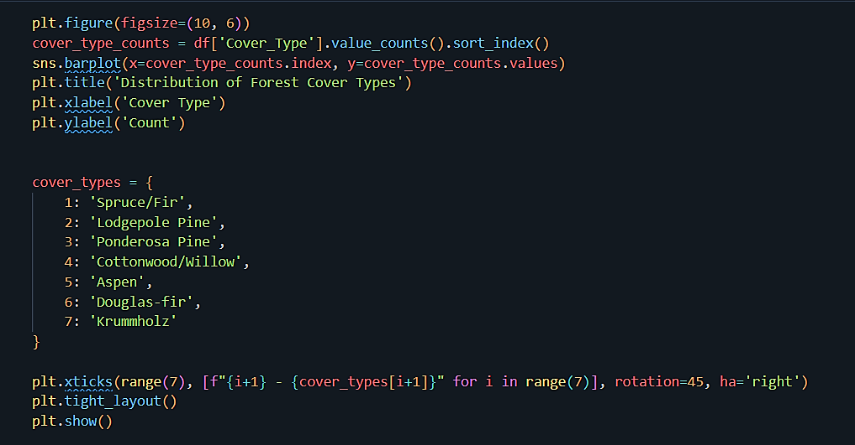
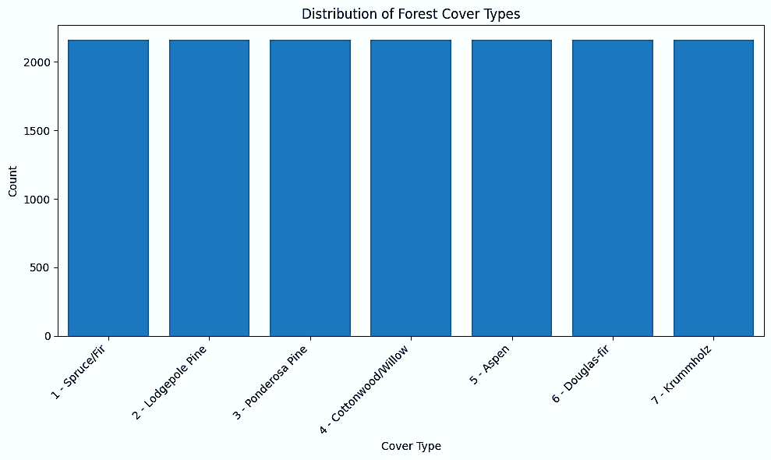
Visualization
Distribution of Forest Cover Types
Aritra Mukherjee

Slide 10
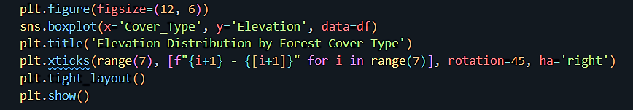
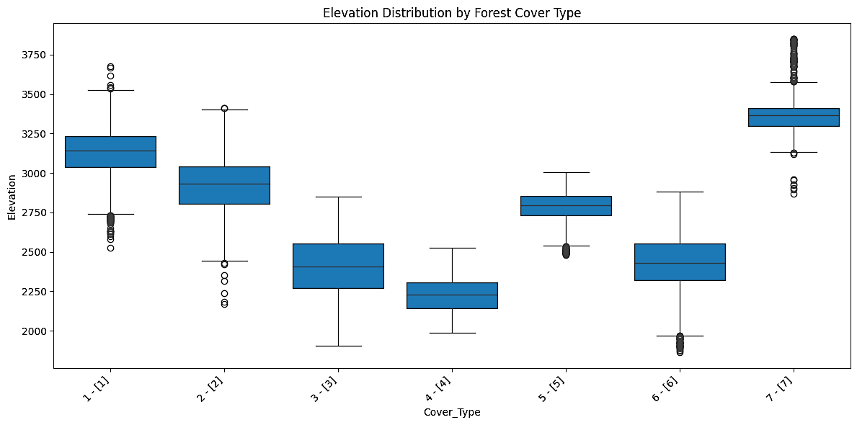
Visualization
Checks how Elevation relates to Cover Type
Aritra Mukherjee

Slide 11
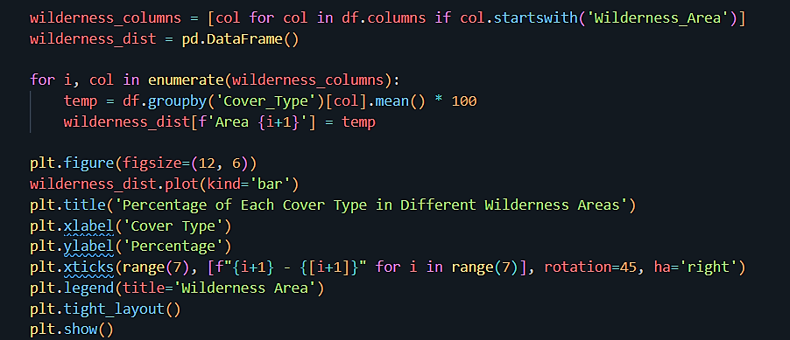
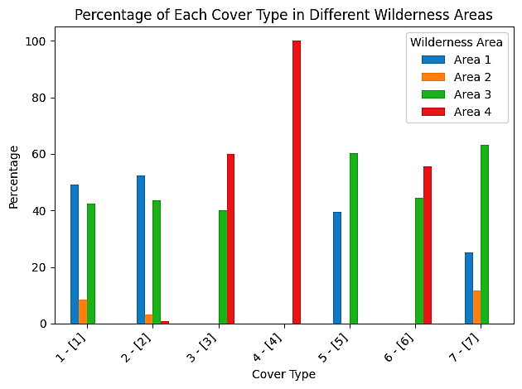
Visualization
Check distribution of wilderness areas per cover type
Aritra Mukherjee

Slide 12
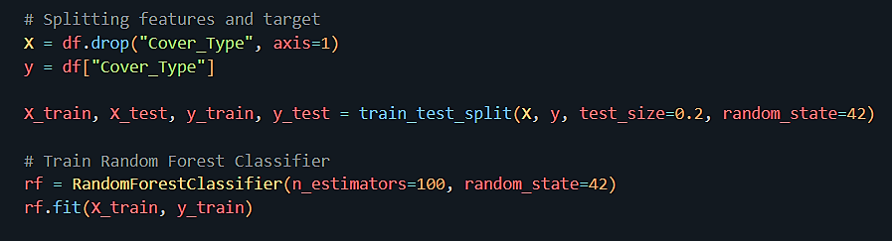
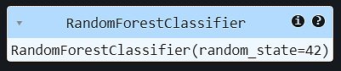
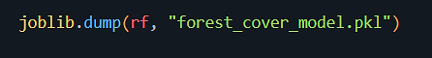
Data Preprocessing
Save the Best Model
Aritra Mukherjee

Slide 13
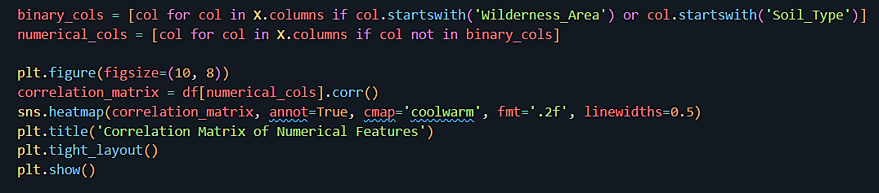
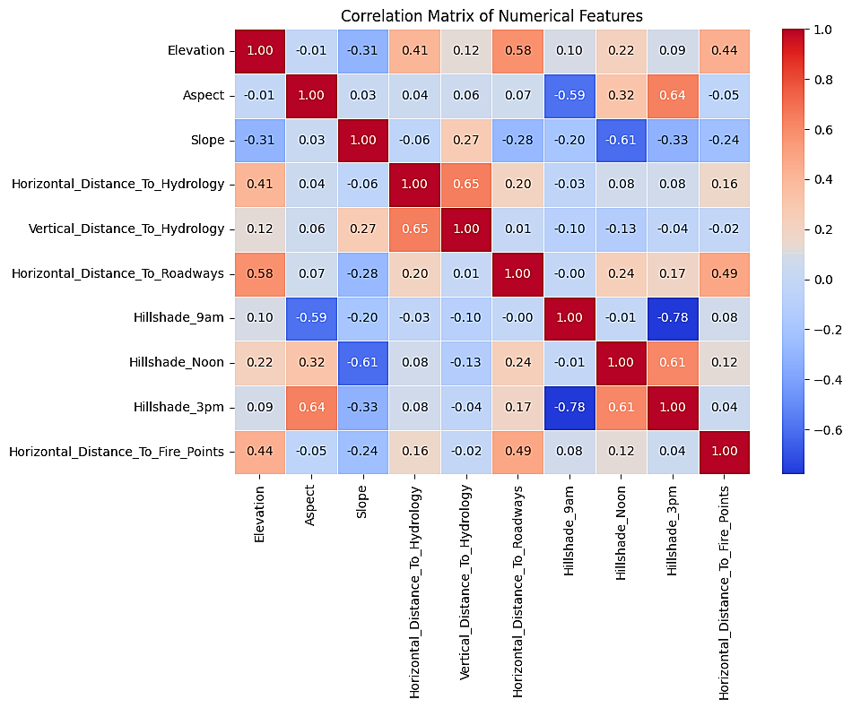
Visualization
Visualize correlations between numerical features
Aritra Mukherjee

Slide 14
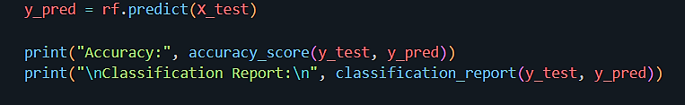
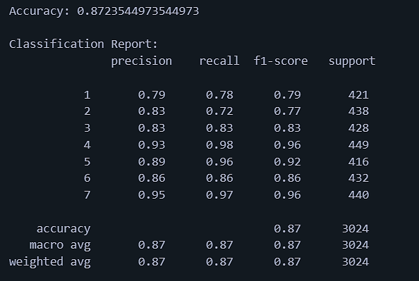
Model Training and Tuning
Accuracy – 87%
Aritra Mukherjee

Slide 15
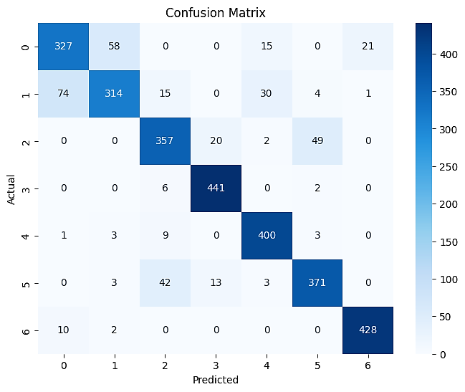
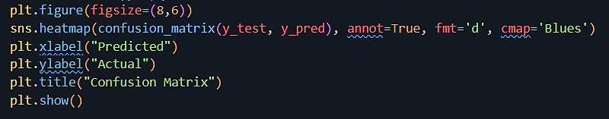
Visualization
Plot the - Confusion Matrix
Aritra Mukherjee

Slide 16
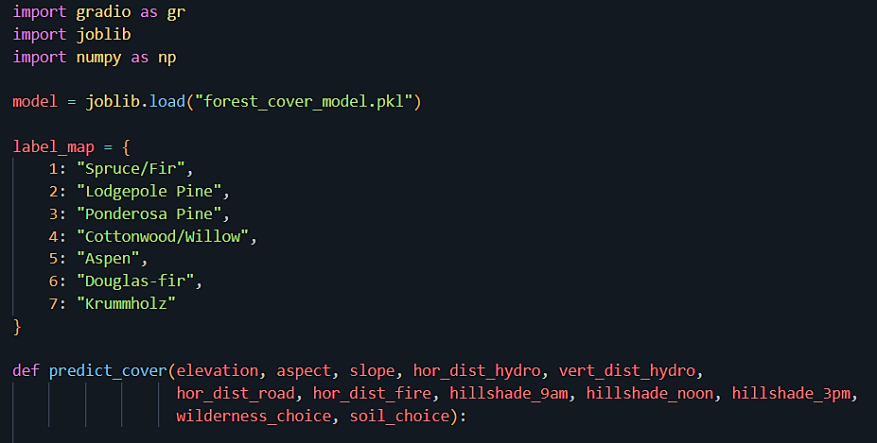
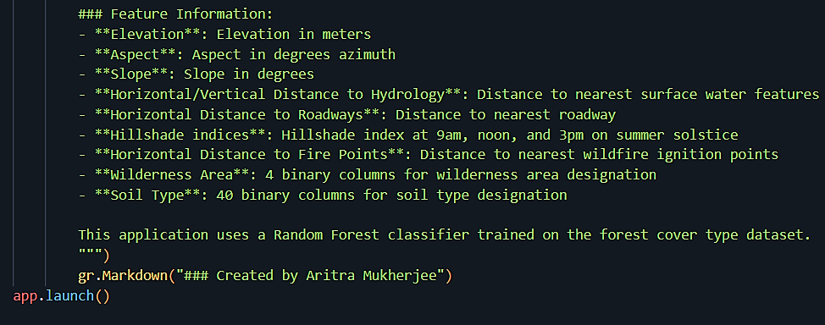
UI APP CODE
. . .
. . .

Slide 17
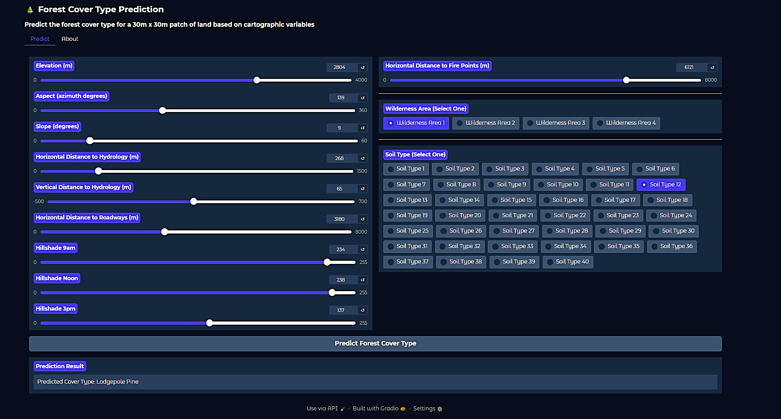
Prediction
Aritra Mukherjee

Slide 18
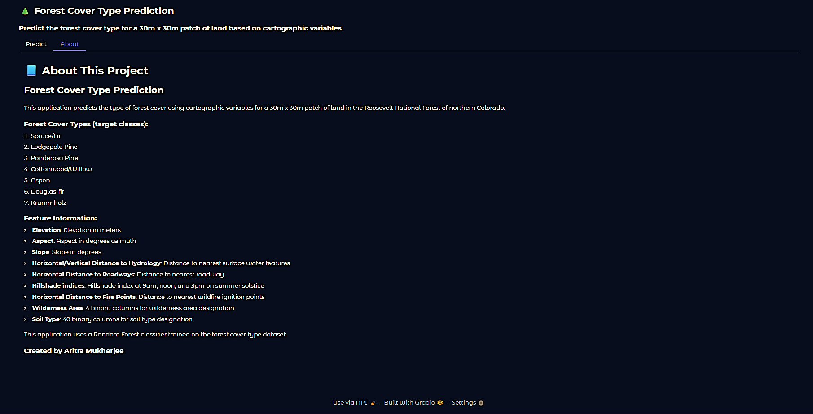
Prediction
Aritra Mukherjee

Slide 19
GitHub Repo Link
GitHub Repo -
Forest-Cover-Prediction-ml-app
Aritra Mukherjee

Slide 20
Conclusion
Successfully built a web app that predicts forest cover type using machine learning.
Useful for forest conservation, geographical analysis, and environmental modeling.
Scalable for further applications like wildfire risk prediction or ecological zoning.
Aritra Mukherjee

